Slide 1

NBA MVP Prediction
By: Kamaal Bartlett

Slide 2
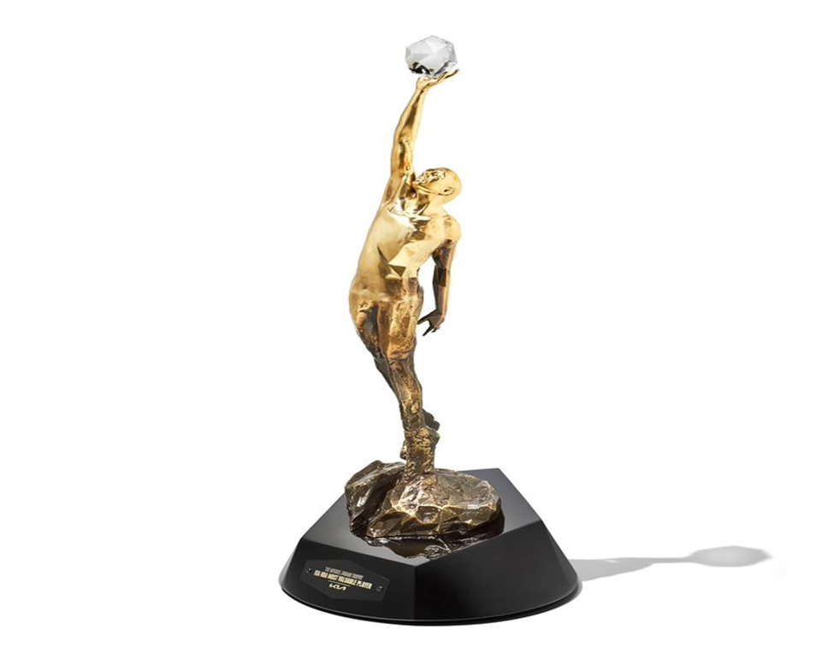
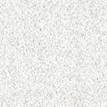
Background
The National Basketball Association (NBA)
The Most Valuable Player (MVP) Award

Slide 3
Problem Statement
How is the award selected?
Can a computer correctly predict an award that requires so much human judgement

Slide 4
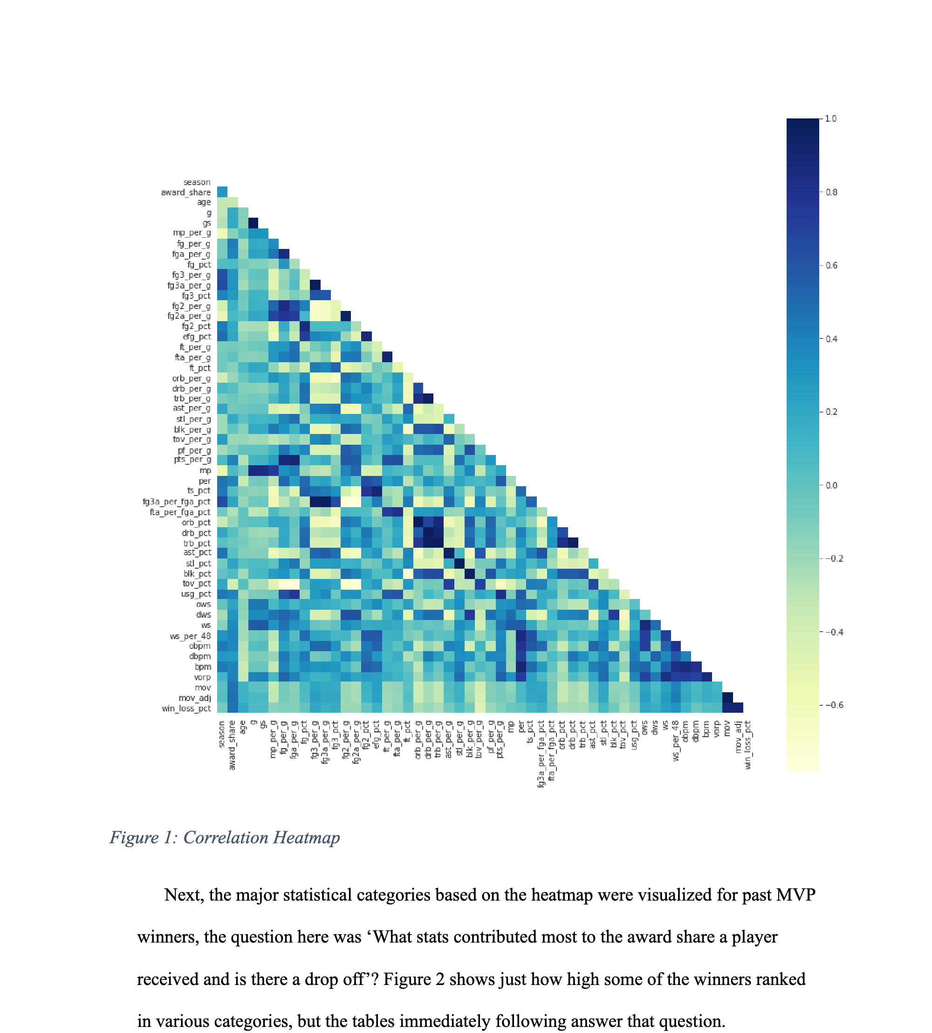
Data Wrangling
First step: Understand the data
Second step: Clean the data
Third step: Plot the relationship between the data to the target variable

Slide 5
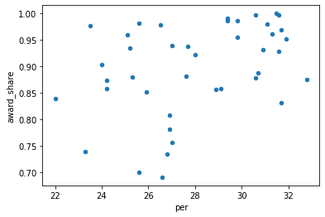
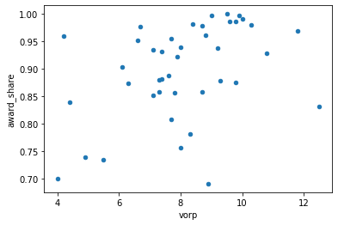
Data Wrangling
Key Metrics

Slide 6
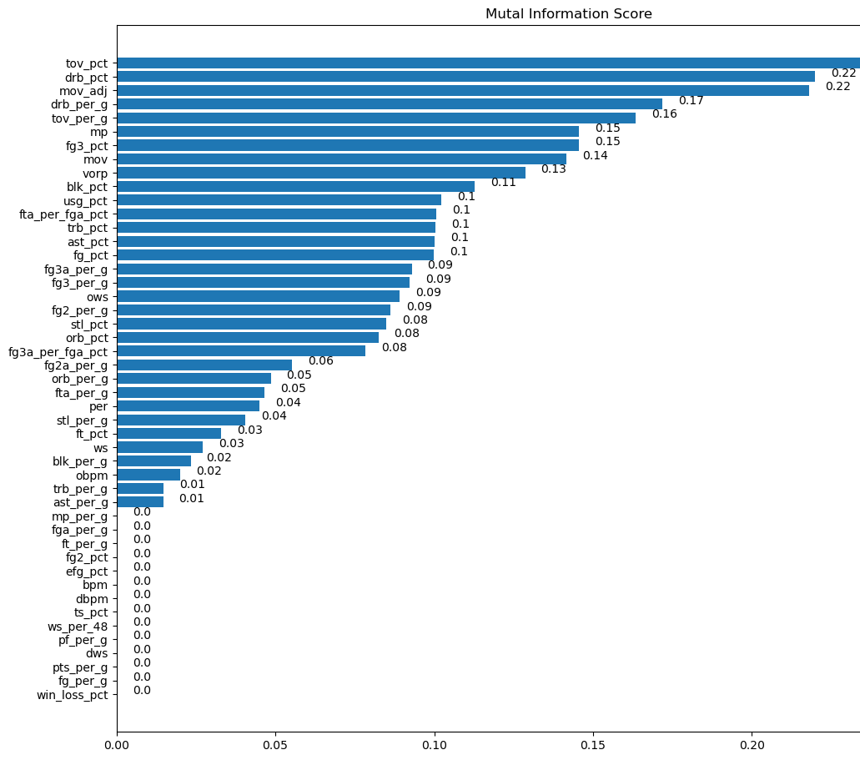
Exploratory Data Analysis
Mutual Information Scores
Most closely related values

Slide 7
Preprocessing
Preparing the data for modeling
Creating a new data set with 2023 statistics

Slide 8
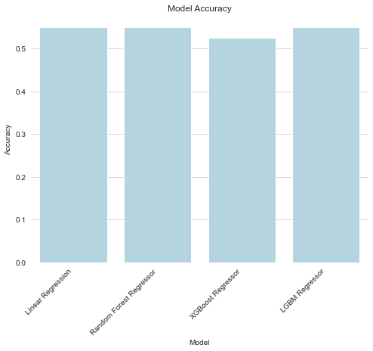
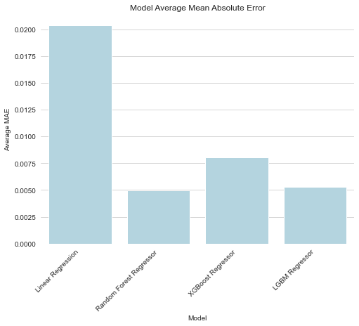
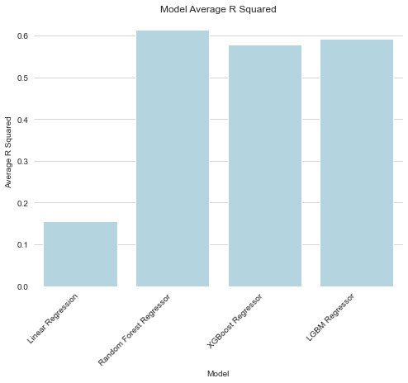
Modeling
Linear Regression questionable
Perform hyperparameter tuning on all other models

Slide 9
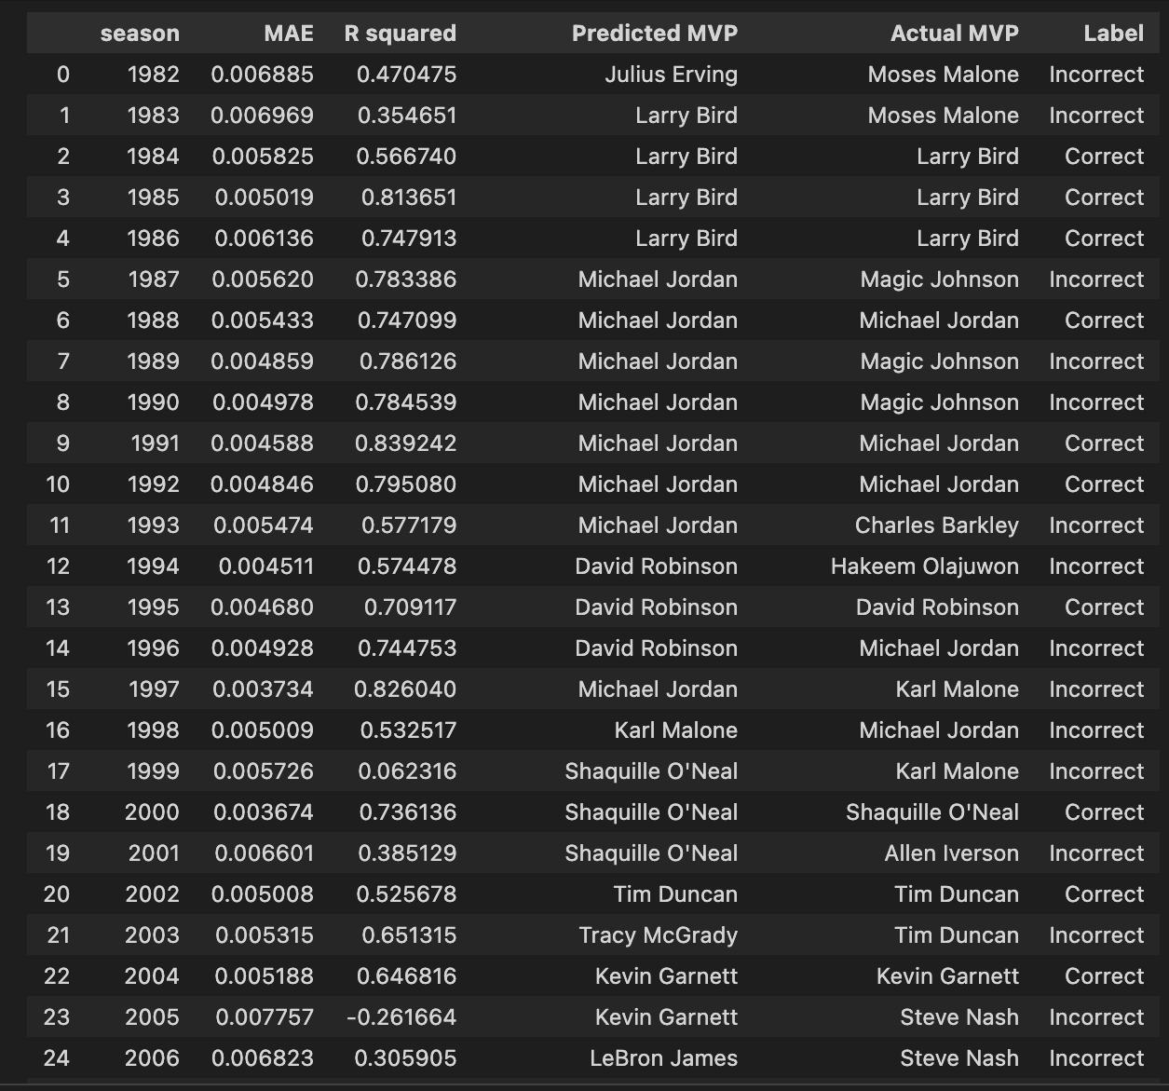
Results
Random Forest results
MAE & R2 varied

Slide 10
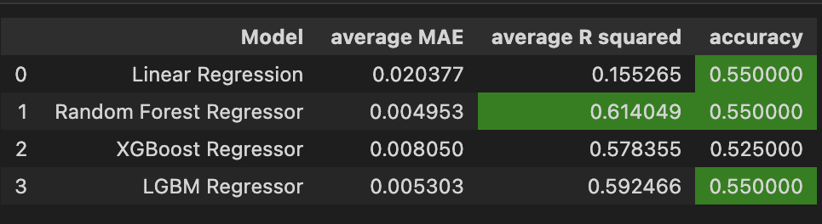
Best Model
Random Forest Regressor

Slide 11

Future Improvements
Hyperparameter tuning
Plot a new heatmap
Fill in blanks using standard deviation or median method

Slide 12
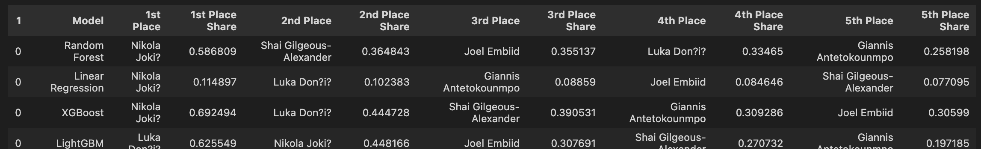
Predictions
Nikola Jokic will win the 2023 NBA MVP award

